Slide 1
Tissue Damage by Novel Corona Virus
Group Member:
Ashlee N. Ford Versypt
Amber Smith
Thomas Hillen
Mohammad Aminul Islam
08-31-20

Slide 2
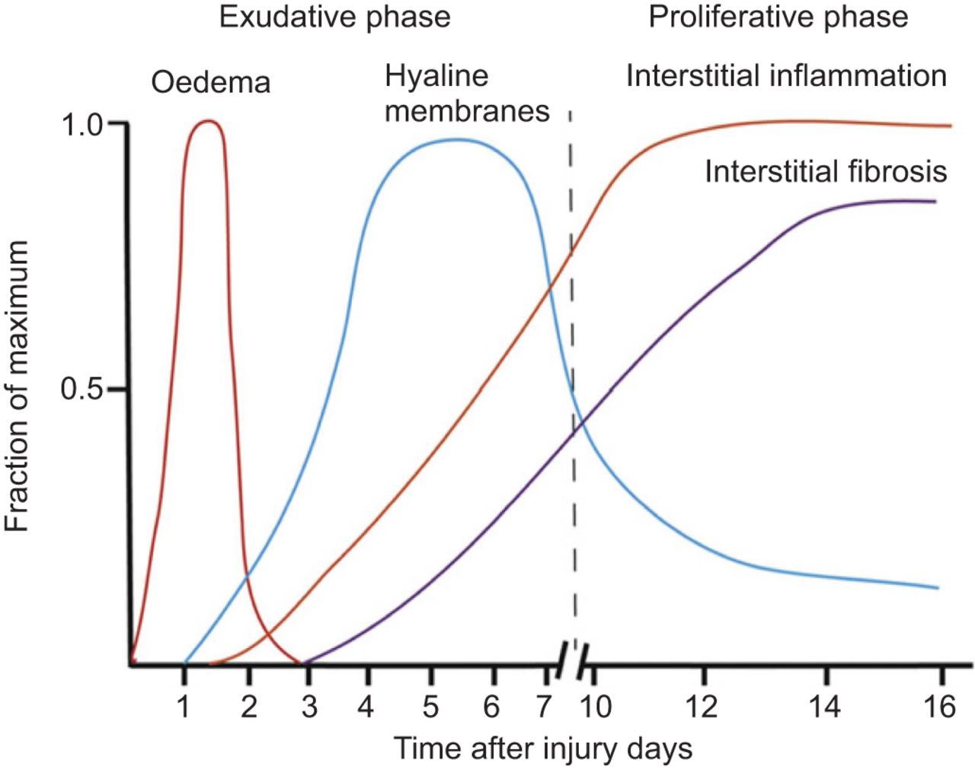
Damage occurs at different phases in acute lung injury
In exudative phase, edema and inflammation occurs and lasts upto 7 days from disease onset.
In proliferative phase, tissue repairs and collagen formation starts (normally from day 7).
Proliferative phase can lead to long term fibrosis.
Exudative and proliferative phase co-exit in whole lung.
Reference: Checkley-Neuregulin-1 as a potentially novel biomarker in acute respiratory distress syndrome
1

Slide 3
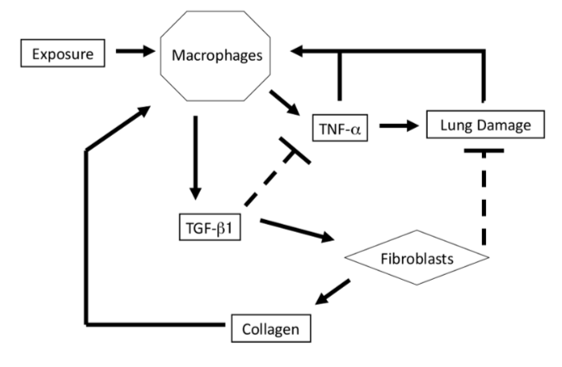
Agent based model for inflammation and fibrosis
Macrophage will be exposed to COVID19
Macrophage will release proinflammatory cytokine in first 7 days
Diffusion of pro inflammatory cytokine will cause tissue damage
Macrophage will release anti inflammatory after 7 days and recruit fibroblast
Fibroblast will move to damage site and repair tissue
Reference: Brown-An agent-based model of inflammation and fibrosis following particulate exposure in the lung-Mathematical biosciences
2

Slide 4
Rules for the lung fibrosis model
F
Tissue life at each grid = 1
M
SARS-CoV2 activated macrophage, recruit macrophage and cleared by macrophage
Pro inflammatory cytokines produce from M1 macrophage will diffuse, reduce tissue life, degrade and recruit macrophage
Anti inflammatory cytokines produce from M2 macrophage will diffuse, degrade, recruit fibroblast and suppress pro inflammatory cytokines
Fibroblast recruited by anti inflammatory cytokines heal tissue and deposit collagen
Excess collagen deposition will activate macrophage
Macrophage moves towards SARS-CoV2, pro inflammatory cytokine and fibroblast towards damage site
2D grid, M = Macrophage, F = Fibroblast
3

Slide 5
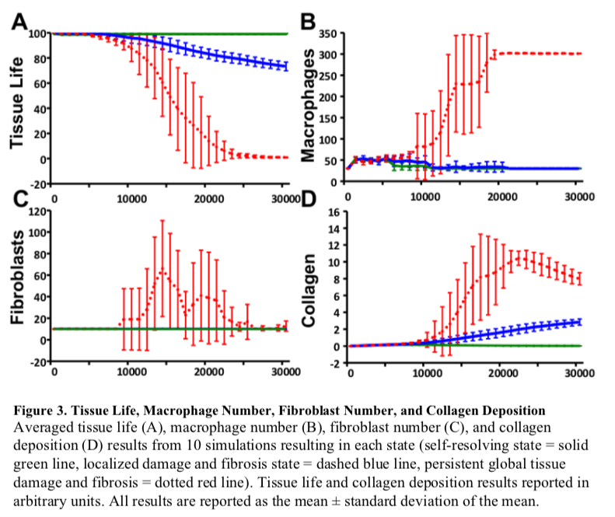
Observables at different exposure
Green: self resolving state
Blue: localized damage and fibrotic state
Red: Global tissue damage and fibrosis
4
Reference: Brown-An agent-based model of inflammation and fibrosis following particulate exposure in the lung-Mathematical biosciences

Slide 6
Connecting renin angiotensin system with COVID19
Homeostasis/steady state solution is evaluated for RAS network
Different physiological conditions are considered (normotensive and hypertensive patients w/wo feedback (β ))
Perturb the system inhibiting ACE2 due to infection
Inhibition of ACE2 upregulate ANGII
ANGII upregulate IL6 and collagen deposition
ANG
COVID19
Renin
c_{Renin}
ACE2
ANGI
X
ANG(1-9)
ACEI
ACE
c_{ACE}
c_{NEP}
NEP
X
ACE
β
Fibrosis
ANGII
C_{ACE2} (1 - f)
ANG(1-7)
ACE2
c_{AT1}
f = I(t) / T
X
ARB
c_{AT2}
c_{APA}
COVID19
AT1R-ANGII
AT2R-ANGII
ANGIV
5

Slide 7
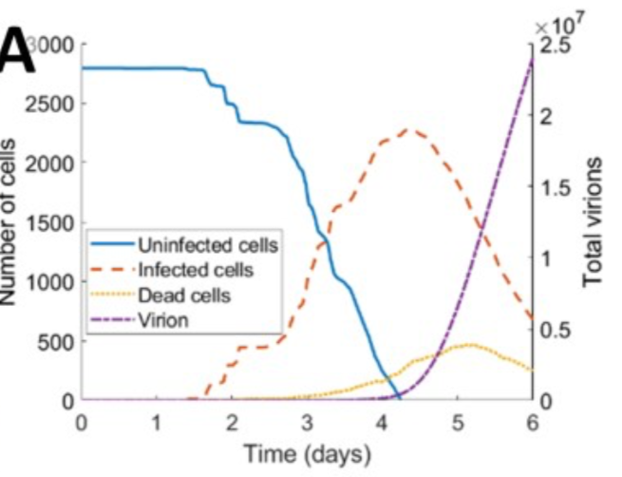
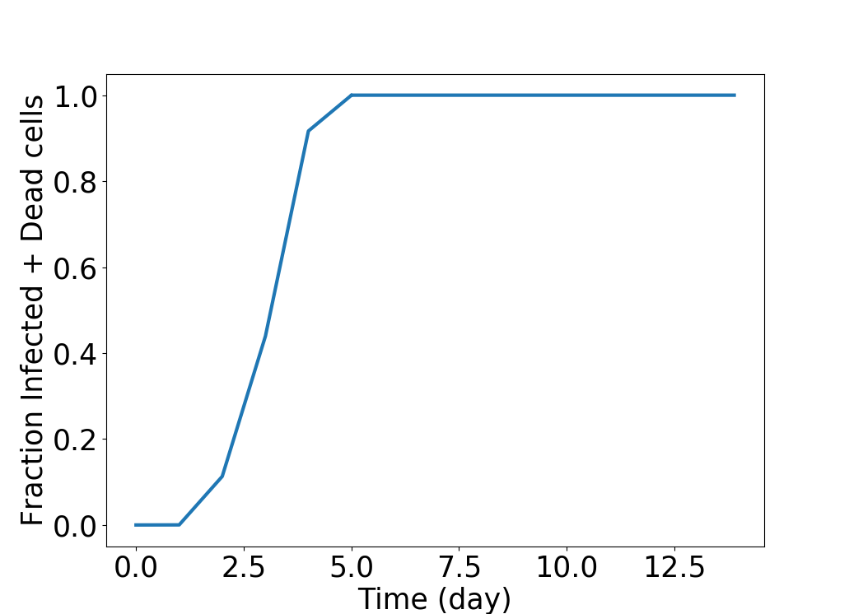
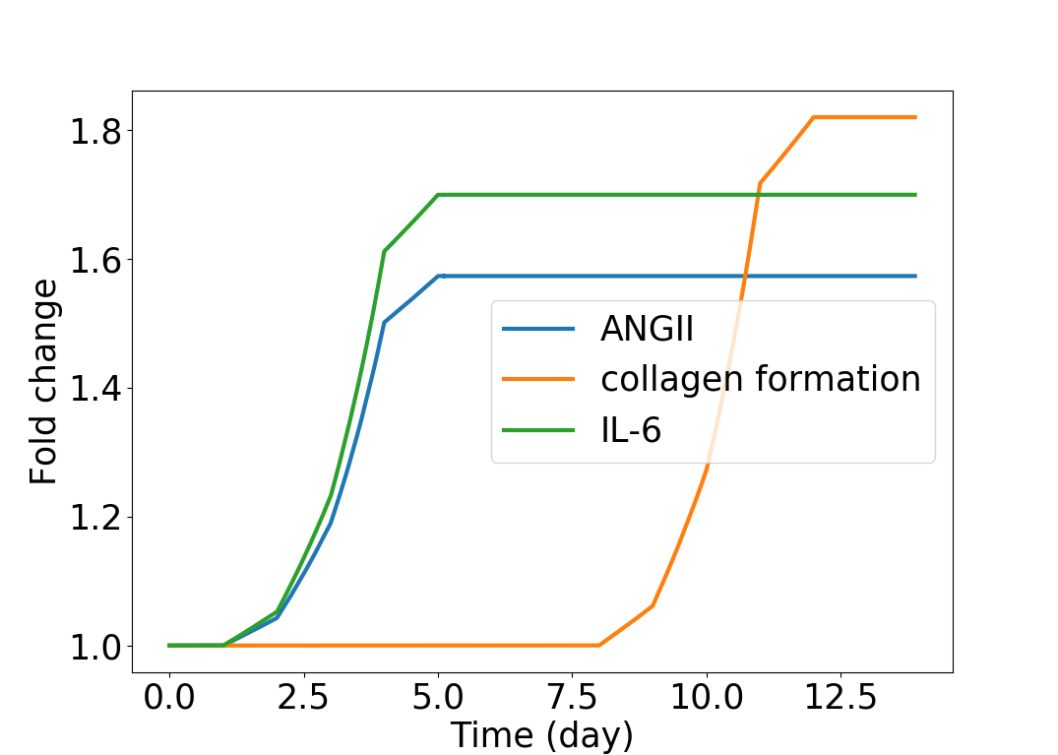
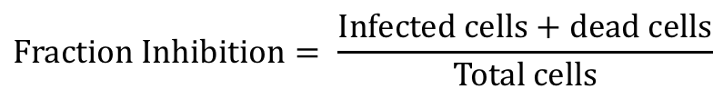
Dynamics of ANGII, IL6 and collagen after infection
$$Fraction Inhibition= \frac{Infected cells+dead cells}{Total cells}$$
6

Slide 8
Supplementary

Slide 9
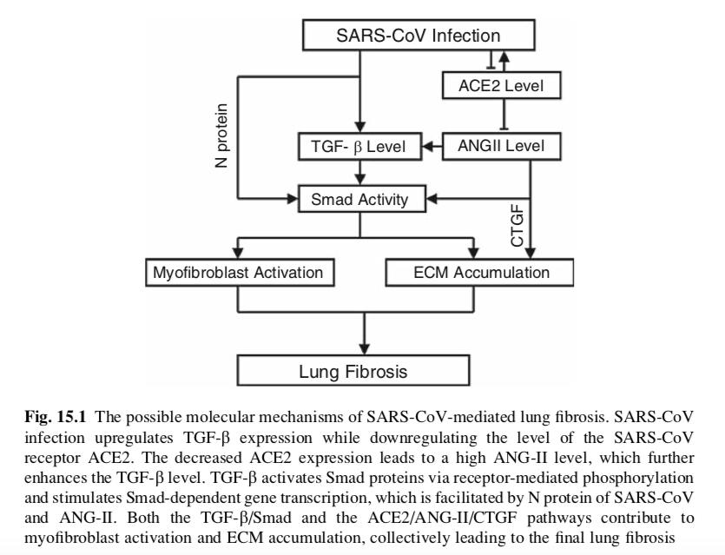
The mechanism of SARS-CoV-2 mediated lung injury
SARS-CoV suppress ACE2 and increase ANGII concentration.
ANGII increases TGF-β and activates downstream signaling resulted lung fibrosis.
SARS-CoV-2 may have similar effect and causes acute lung injury.
Modeling the data driven correlation between ANGII and fibrosis (collagen deposition) skipping intermediate interactions.
Reference: Zuo-SARS coronavirus and lung fibrosis-Molecular Biology
1

Slide 10
In vivo experimental result reveals ANGII increases collagen deposition
 | ANGII concentration pg/g lung |  | Change in Collagen mg/lung
Time (days) | Control | Bleomycin | Control | Study 1 | Control | Study 2
3 | 189 ± 23 | 255 ± 43 | - | - | - | -
7 | 174 ± 35 | 288 ± 35 | - | - | - | -
14 | 195 ± 27 | 352 ± 51 | 19 ± 0.5 | 38 ± 4 | 21 ± 0.2 | 36 ± 2
21 | 200 ± 13 | 369 ± 27 | 20 ± 0.5 | 41 ± 4 | 21.5 ± 0.2 | 38 ± 2
Interpretation: 1.85-fold change of ANGII will increase the collagen amount by 2.05-fold at 21 days in study 1.
Reference: Marshall-Angiotensin II and the fibroproliferative response to acute lung injury-American Journal of Physiology-Lung Cellular and Molecular Physiology
2

Slide 11
Complete knockout of ACE2 increases collagen deposition
Interpretation (Top Table)
Complete knockout of ACE2 will increase the collagen amount by 1.62-fold from control.
ANGII concentration ng/mL (in vitro) |  |  | Change in Collagen HP, μg/left lung (in vivo)
Control | Bleomycin | Bleo + DX (ACE2 K.O.) | Control | Bleomycin | Bleo + DX (ACE2 K.O.)
0.15 ± 0.01 | 0.3 ± 0.06 | 1.2 ± 0.5 | 51.4 ± 5.2 | 65.5 ± 6.1 | 83.4 ± 5.7
Interpretation (Bottom Table)
Complete knockout of ACE2 will increase the collagen amount by 1.56-fold in male patients.
In female patients’ complete knockout of ACE2 increase the collagen amount by 1.1-fold.
Collagen deposition differs because of high AT2/AT1 ratio is higher in female.
 | Collagen μg/g
Gender | Control | Bleo + ACE2 K.O.
Male | 55 ± 3.6 | 86 ± 20
Female | 52.8 ± 2.2 | 58 ± 6
Reference: Li-American Journal of Physiology-Lung Cellular and Molecular Physiology 295.1 (2008): L178-L185
Rey: Journal of molecular medicine 90.6 (2012): 637-647.
3

Slide 12
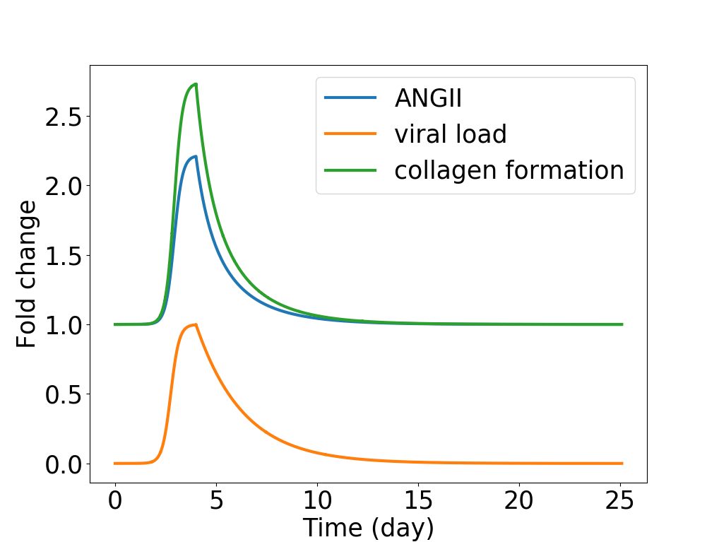
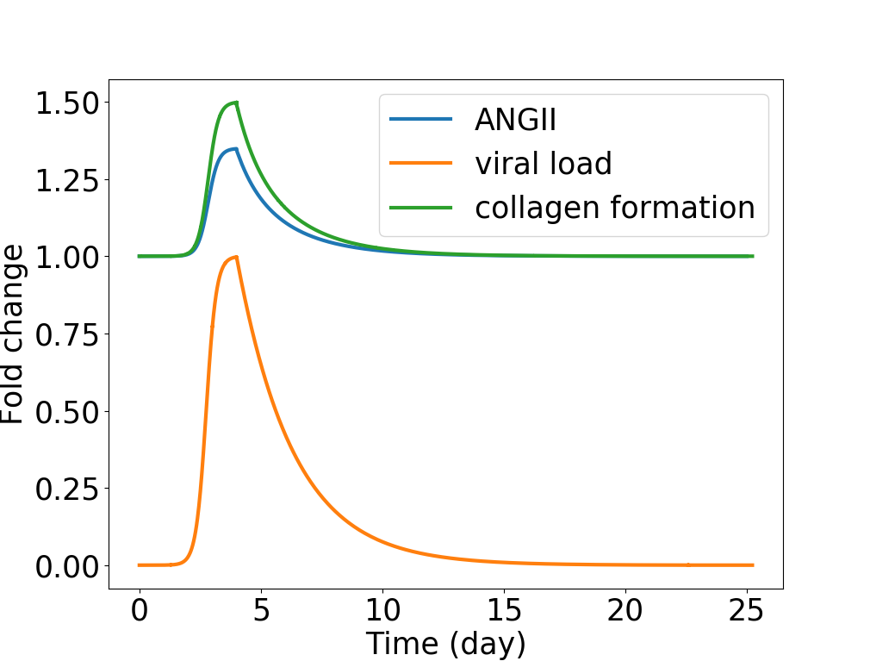
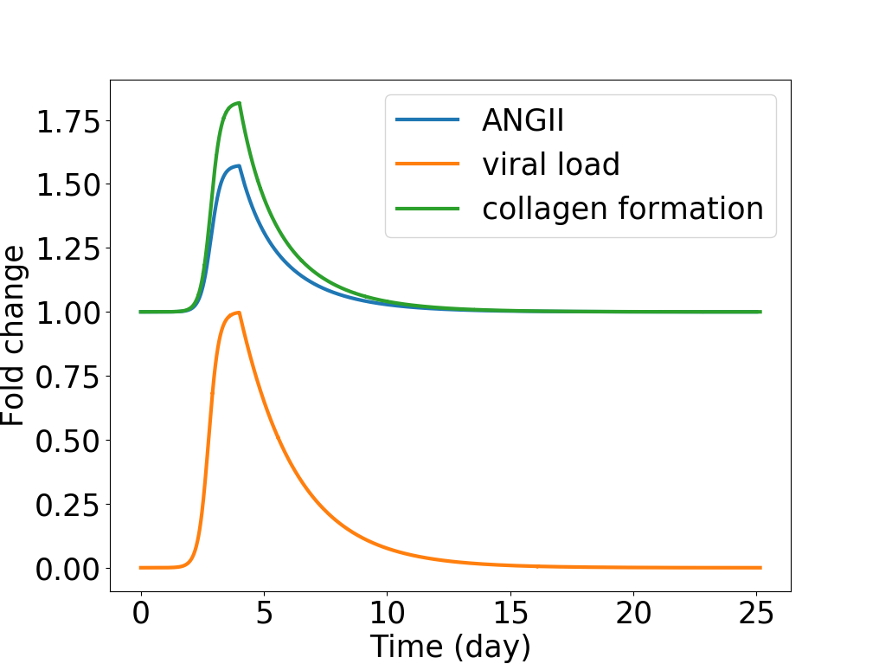

Simulated results recreate the change in collagen deposition with ACE2 knockout
Normotensive without feedback
Normotensive with feedback
Case | ANGII | Collagen
Normotensive without feedback | 2.22 | 2.74
Normotensive with feedback | 1.35 | 1.50
Hypertensive without feedback | 1.57 | 1.82
Hypertensive with feedback | 1.35 | 1.50
Complete inhibition of ACE2 yields experimentally observed fold-change of collagen with downstream feedback.
The collagen deposition will be higher with impair downstream signaling as shown in cases of without downstream feedback.
Hypertensive without feedback
Hypertensive with feedback
4

Slide 13
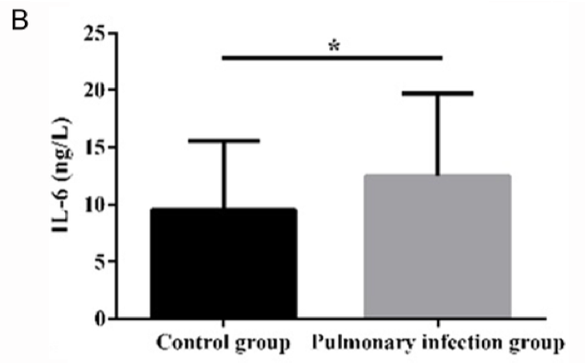
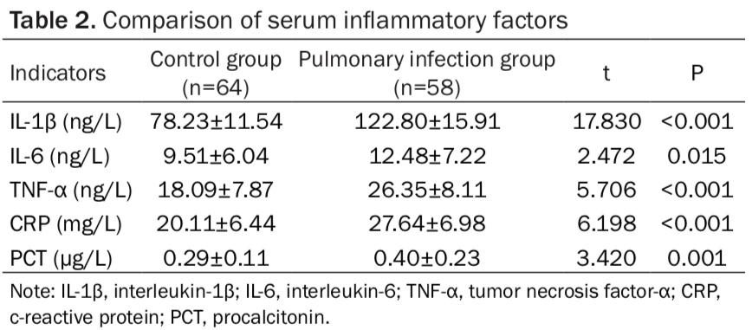
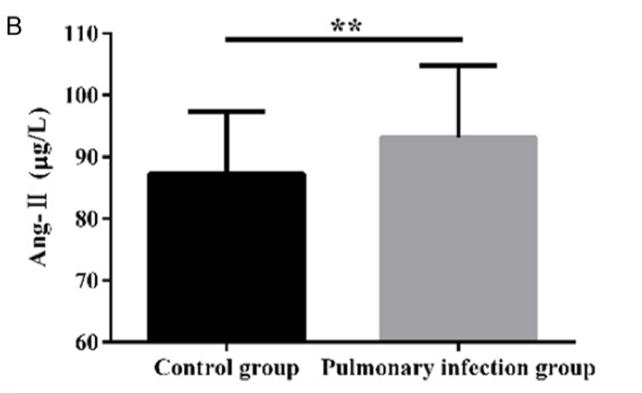
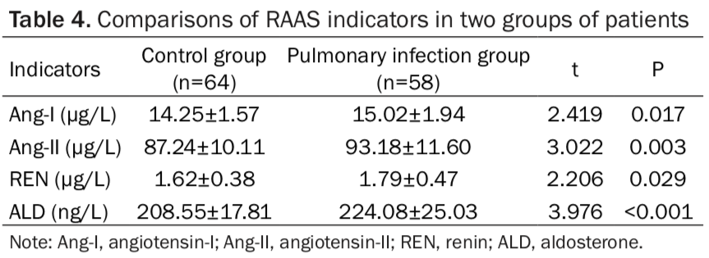
IL-6 -fold change related to ANGII for pulmonary infection
Interpretation: 1.07-fold increase of ANGII increase IL-6 by 1.31-fold in pulmonary infection group. (ANGII:IL-6 = 1:1.22)
Reference: Li-Effect and mechanism of pulmonary infection on immune function and renin-angiotensin-aldosterone system in patients with severe acute pancreatitis-International Journal of Clinical and Experimental Medicine
5

Slide 14
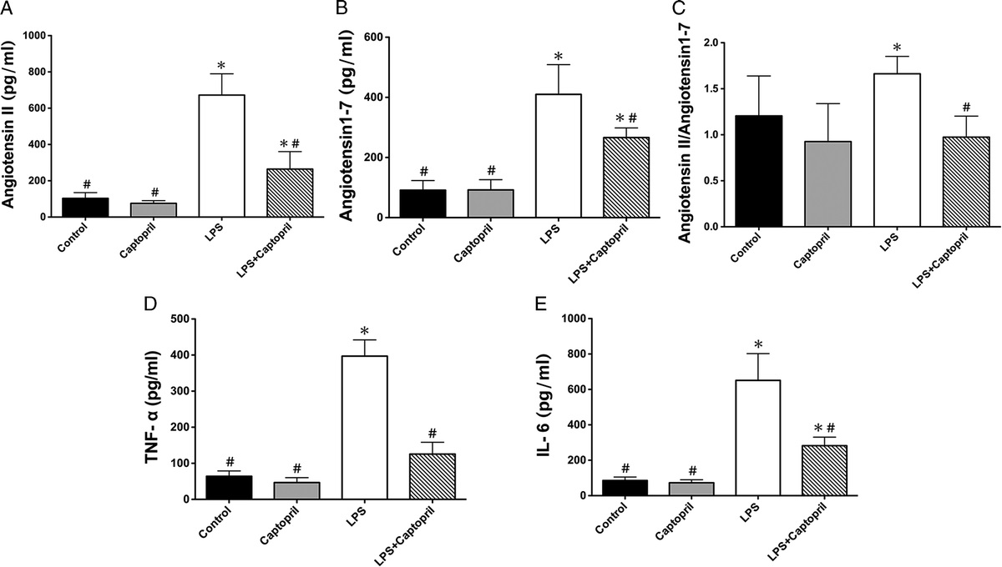
IL-6 -fold change related to ANGII for LPS induced lung injury
 | ANGII (pg/mL) | IL-6 (pg/mL)
Control | 110 ± 38 | 94 ± 14
LPS | 674 ± 115 | 656 ± 146
Interpretation: 6.13-fold increase of ANGII increase IL-6 by 6.98-fold in lung injury group. (ANGII:IL-6 = 1:1.14)
Reference: Li-Angiotensin-converting enzyme inhibition attenuates lipopolysaccharide-induced lung injury by regulating the balance between angiotensin-converting enzyme and angiotensin-converting enzyme 2 and inhibiting mitogen-activated protein kinase activation-Shock
6

Slide 15
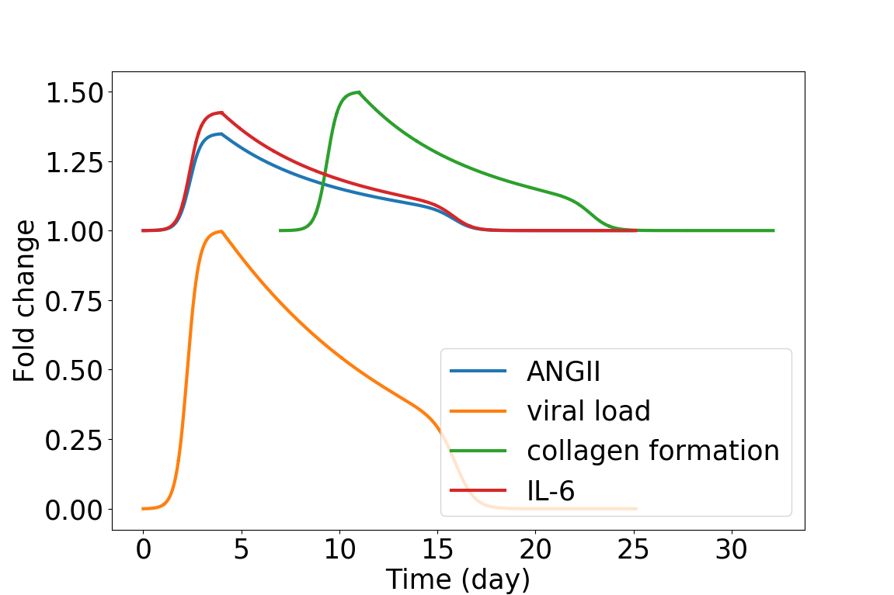
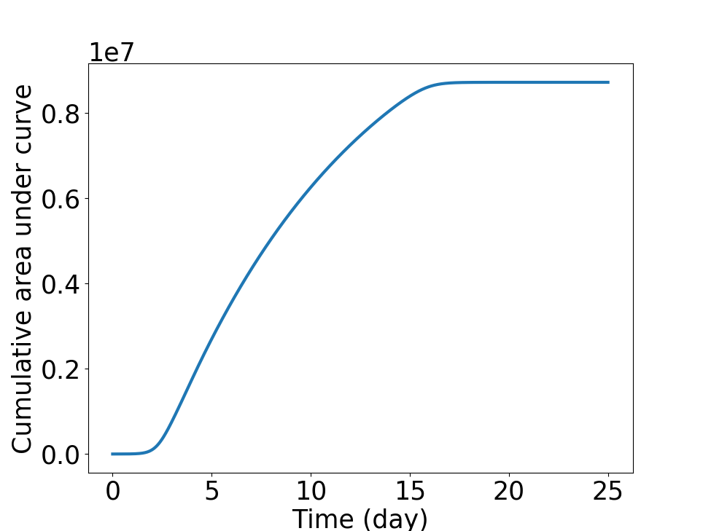
Predicting the dynamics of collagen deposition and IL-6 from ANGII
Curve for collagen deposition is shifted by 7 days since no interaction is considered between ANGII and collagen
Sequence and accuracy in the dynamics of IL-6 and collagen deposition
A simple time delay in the model or complex interaction with feedback using DDE
Area under curve for viral load and connect it with ACE2
Timeframe of susceptibility for the AUC after viral load tapers off
What is the threshold of AUC before starting to see effects
Viral load
7

Slide 16
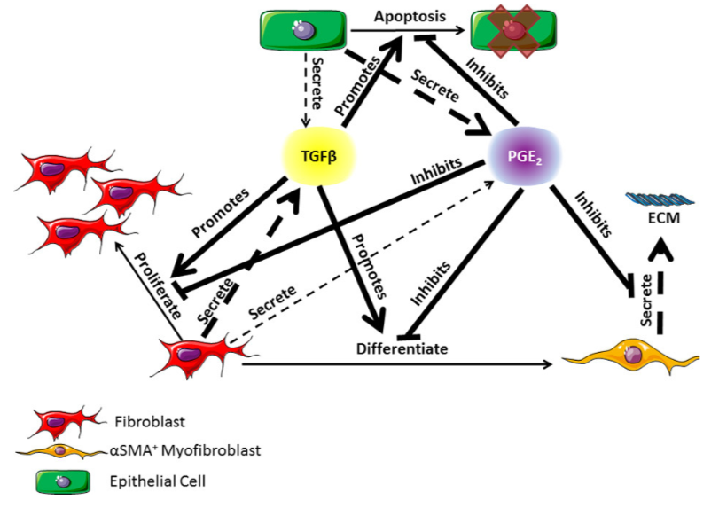
Agent based model for epithelial cell death and fibrosis
Epithelial cells release profibrotic agents
Pro-fibrotic agent cause cellular death and increase collagen deposition
Reference: Warsinske-Computational modeling predicts simultaneous targeting of fibroblasts and epithelial cells is necessary for treatment of pulmonary fibrosis-Frontiers in pharmacology
8

